Slide 1

ACADEMIC AND RESEARCH INTEGRITY
NIDA ABID UE-22001
AMNA NAZ UE-22003

Slide 2

WHAT IS ACADEMIC AND RESEARCH INTEGRITY?
Academic and research integrity involves honest and fair schoolwork and research.
It emphasizes truthfulness, avoiding cheating and plagiarism.
Giving proper credit to sources is essential.
Integrity helps maintain the respect and credibility of educational institutions.
Ensures fair and honest learning and research practices.

Slide 3

WHY IS ACADEMIC AND RESEARCH INTEGRITY IMPORTANT?
PRESERVING TRUST: It helps maintain trust and credibility within educational institutions. When students, faculty, and researchers uphold integrity, others can have confidence in the academic system.
FAIRNESS: It ensures a level playing field for all students. It promotes fairness by preventing dishonest practices that could give some students an unfair advantage.
EDUCATIONAL VALUE: Upholding integrity enhances the educational value of assignments, research, and exams. It encourages students to engage deeply with their studies and develop critical thinking skills.
RESEARCH CREDIBILITY: In the realm of research and academia, integrity is crucial for producing credible and reliable knowledge. It ensures that research findings are trustworthy and can be built upon by others.

Slide 4

Examples of academic and research integrity violations
Plagiarism
Cheating on Exams
Fabricating Data
Bribery

Slide 5

PLAGIARISM:
Plagiarism refers to the act of using someone else’s work, ideas, words, or intellectual property without proper attribution or permission and presenting as its own ..

Slide 6

Cheating on exams:
Cheating involves dishonest practices aimed at gaining an unfair advantage in assessments, exams, assignments or any educational activity. It undermines the principles of fairness and honest effort in learning.

Slide 7

FABRICATION:
Fabrication involves the act of inventing or falsifying information, data, results, or details in academic work, research or assignments.It typically presents false or nonexistent information as if it were factual.

Slide 8
HOW TO AVOID ACADEMIC AND RESEARCH INTEGRITY VIOLATIONS?
Site your sources properly
Paraphrase and summarize other people’s work in your own words
Keep track of your sources and take good notes
Ask for help from your tutor if you are struggling with an assignment

Slide 9
CASE STUDY:
Amna, Dua, and Nida are assigned to work on several group assignments together in a history class this semester. One of their projects includes each of them researching different events on a given timeline, and then combining the information together.On a test that covers some of the information gathered by Dua, Nida cannot remember what the answers are. She reasons that because the three of them had worked on the project together as a collaboration and got a good grade, it shouldn't be a problem to ask Dua what the answers are. Since they sit not far from each other in class, Nida asks Dua to tell her the answers. Dua does not want to offend her friend, so she moves her arm so Nida can see her paper. Amna also sits nearby and sees this.
Is this plagiarism/academic dishonesty? Are all three of them at fault? Is Nida more so than Dua? Is Amna obligated to tell the instructor what she saw?

Slide 10
Yes, this scenario represents academic dishonesty, as Nida's actions constitute cheating by copying from Dua during the test. All three of them share some degree of fault; Nida for asking for answers, Dua for providing them, and Amna for witnessing the act. Nida bears more responsibility than Dua because Nida initiated the cheating by asking for the answers. Amna is indeed obligated to inform the instructor about what he saw, but she should first try to convince his friends to come forward themselves.
RESPONSE:

Slide 11

conclusion
Academic and research integrity is the foundation of an honest and fair education system.Upholding it preserves trust, ensures fairness, and fosters ethical growth .To avoid voliations, cite sources, paraphrase, track references and seek help when needed.

Slide 12
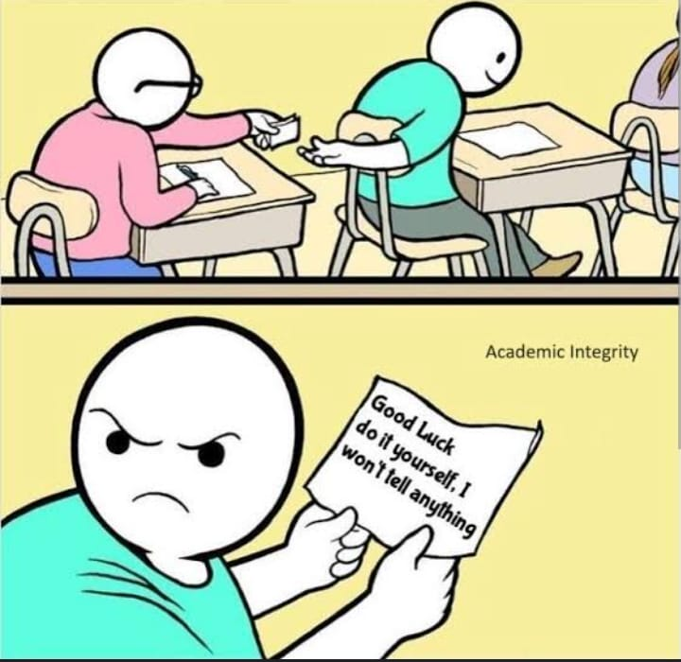
When your friend asks for help during the quiz, but you remember the importance of academic integrity.
THANKYOU.

